Slide 1

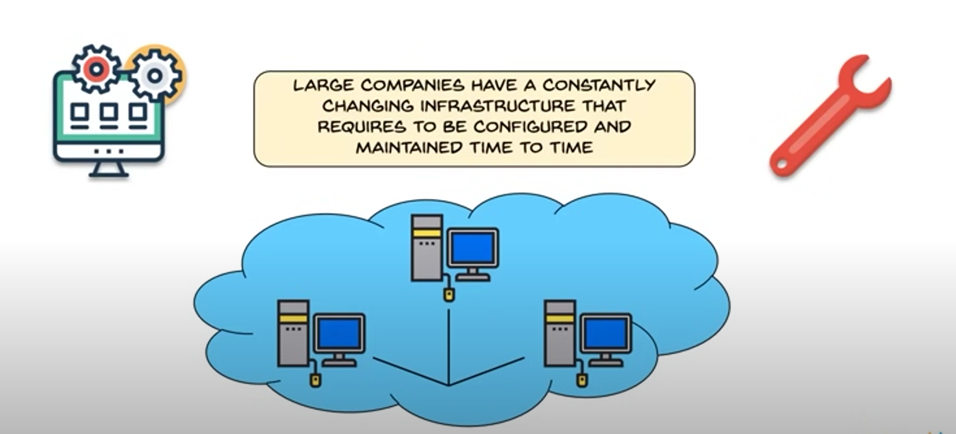
CHEF
Open source developed using Ruby, mainly used to manage infrastructure on physical or virtual machines
It uses Pull configuration and it is Infrastructure as Code
WHY USE CHEF ?
Used mainly to reduce the complexity of managing an infrastructure.

Slide 2
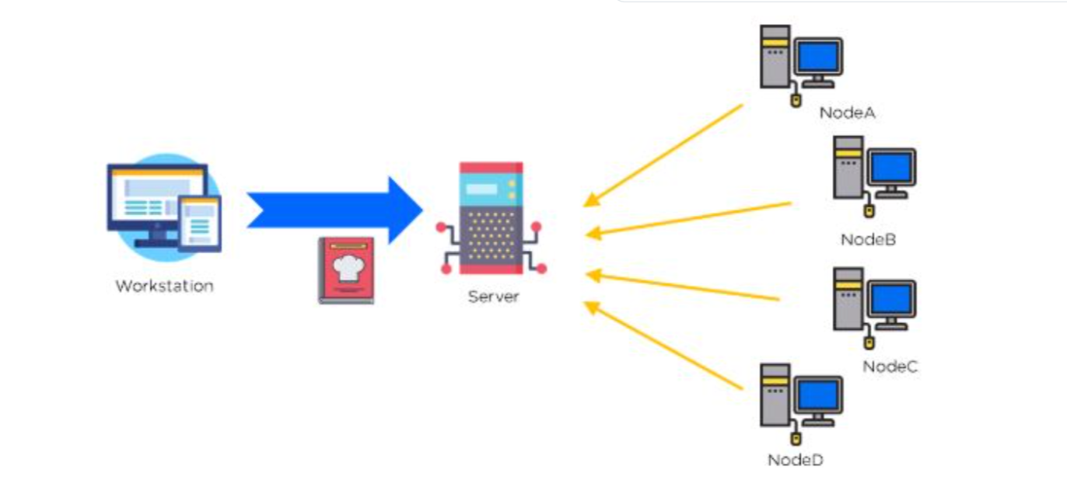
CHEF ARCHITECTURE
OHAI
It is a Three Tier Architecture

Slide 3
WORKSTATION
It is set by system administrator.
Once code is ready for production, it can be pushed to a Chef server, where it is stored and made available to nodes
It also allows developers and operations teams to work together to create and manage Chef code.
The code written in Ruby is called Recipe and collection of it called Cookbooks

Slide 4
SERVER
It is intermediate between workstation and nodes.
Cookbooks are stored here with help of Knife(Command Line Tool)
Can be hosted on
Workstation
Remote
Cloud
It Stores all the configuration files

Slide 5
NODE
It is a system requires configuration.
OHAI is a service installed on Node and responsible for collection all information about current state of node.
This information is sent over the server.
When node has demand for recipe , Chef client is responsible for it.

Slide 6

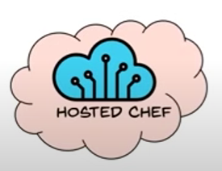
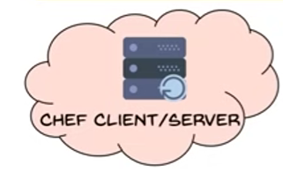
FLAVOURS
CHEF SOLO
HOSTED CHEF
CHEF CLIENT/SERVER

Slide 7
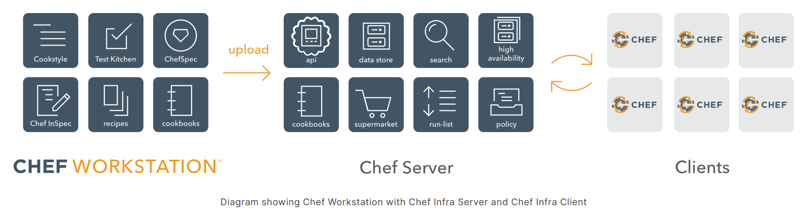
Chef Infra
Chef Infra is a powerful automation platform that transforms infrastructure into code. Whether you’re operating in the cloud, on-premises, or in a hybrid environment, Chef Infra automates how infrastructure is configured, deployed, and managed across your network, no matter its size.

Slide 8
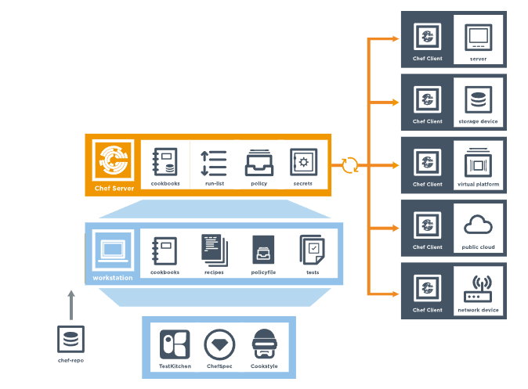
Diagram of Chef Infra Client, Server, and Workstation

Slide 9

Chef Workstation
A workstation is your local computer running Chef Workstation that you use to author cookbooks, interact with the Chef Infra Server, and interact with nodes. The workstation is where users do most of their work, including:
Developing and testing cookbooks
Keeping the Chef Infra repository synchronized with version source control
Configuring organizational policy by including defining roles and applying Policy files or policy groups
Interacting with nodes, as (or when) required, such as performing a bootstrap operation
One (or more) workstations are configured to allow users to author, test, and maintain cookbooks.
Workstation systems run the Chef Workstation package which includes tools such as Chef Infra Client, Chef InSpec, Test Kitchen, ChefSpec, Cookstyle, and other tools necessary for developing and testing your infrastructure with Chef products.

Slide 10



Nodes
A node is any device—physical, virtual, cloud, network device, etc.—that is under management by Chef Infra.
The key components of nodes that are under management by Chef include:
Chef Infra Client is installed on each node that is managed with Chef Infra. Chef Infra Client configures the node locally by performing the tasks specified in the run-list. Chef Infra Client will also pull down any required configuration data from the Chef Infra Server during a Chef Infra Client run.
Ohai is a tool for collecting system configuration data, which it then provides to Chef Infra Client to use in cookbooks. Chef Infra Client runs Ohai at the start of every Chef Infra run to determine system state. The attributes that Ohai collects are called automatic attributes. Chef Infra Client uses these attributes to ensure that nodes are in the desired state after each configuration run.

Slide 11
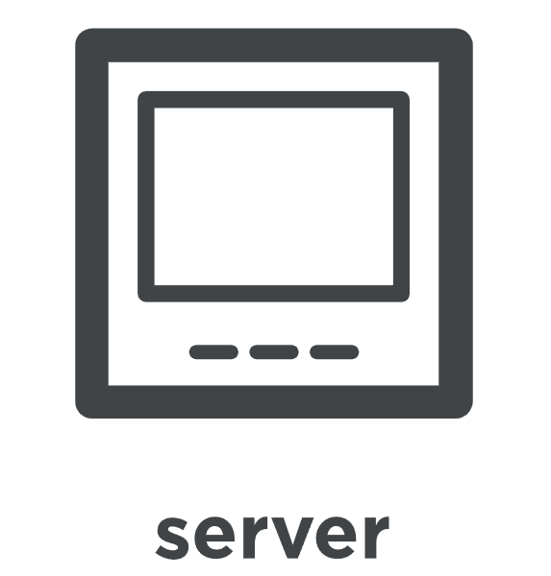

Node Types
A physical node is any active device attached to a network that can run a Chef Infra Client and also allow that Chef Infra Client to communicate with a Chef Infra Server.
A cloud-based node is hosted in an external cloud-based service, such as Amazon Web Services (AWS), OpenStack, Rackspace, Google Compute Engine, or Microsoft Azure. Plugins are available for knife that provide support for external cloud-based services. knife can use these plugins to create instances on cloud-based services.

Slide 12
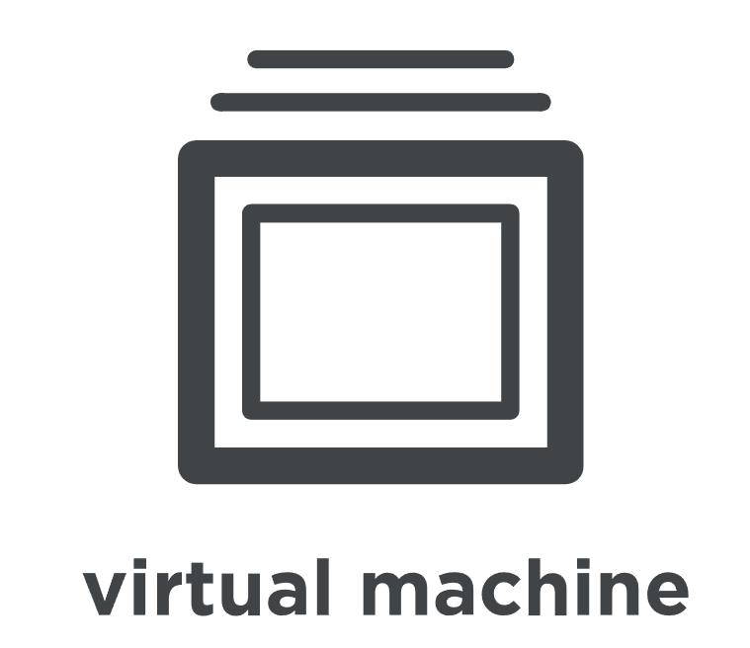
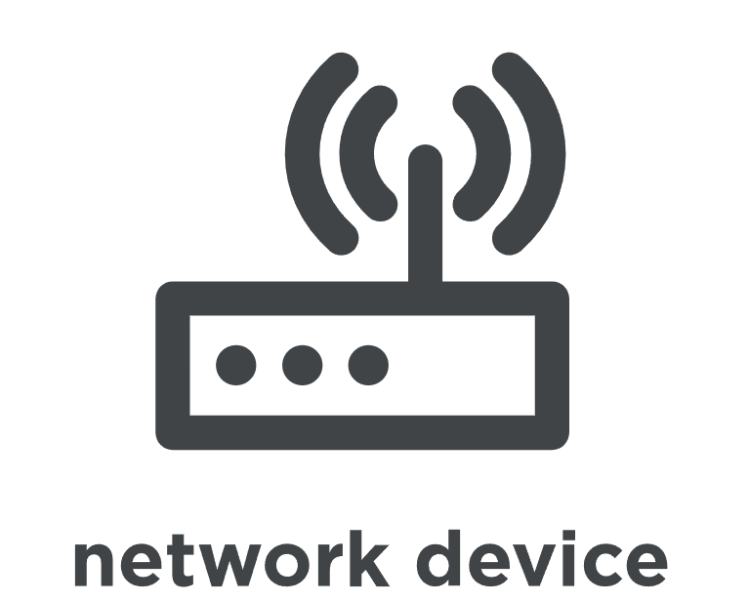
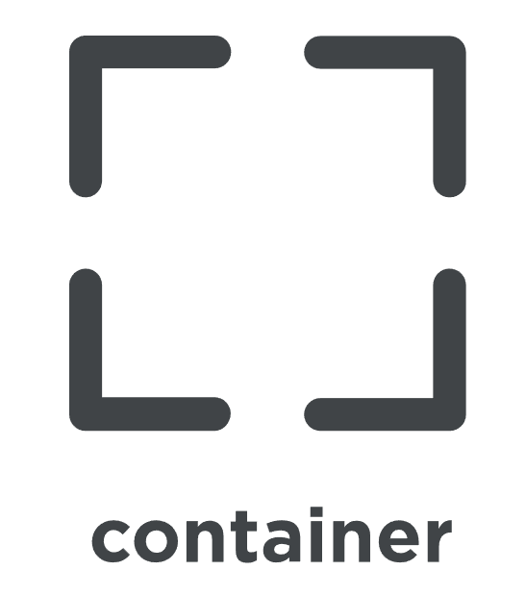
A virtual node is a machine that runs only as a software implementation, but otherwise behaves much like a physical machine.
A network node is any networking device---a switch, a router---that is being managed by a Chef Infra Client, such as networking devices by Juniper Networks, Arista, Cisco, and F5. Use Chef to automate common network configurations, such as physical and logical Ethernet link properties and VLANs, on these devices.
Containers are an approach to virtualization that allows a single operating system to host many working configurations, where each working configuration---a container---is assigned a single responsibility that is isolated from all other responsibilities.

Slide 13
Chef Repo
The chef-repo is a directory on your workstation that stores everything you need to define your infrastructure with Chef
Cookbooks
Data bags
Policyfiles
The chef-repo directory should be synchronized with a version control system, such as git. All of the data in the chef-repo should be treated like source code.
Knife is a command-line tool that provides an interface between a local chef-repo and the Chef Infra Server.
It perform a wide range of operations,such as
Uploading cookbooks and recipes to the Chef server.
Querying the Chef server for information about nodes, cookbooks, and other resources.
Notes:
The chef-repo is the repository structure in which cookbooks are authored, tested, and maintained:
The directory structure within the chef-repo varies. Some organizations prefer to keep all of their cookbooks in a single chef-repo, while other organizations prefer to use a chef-repo for every cookbook.

Slide 14
CookBook
A cookbook is the fundamental unit of configuration and policy distribution in Chef Infra.
Cookbooks contain values and information about the desired state of a node.
Using the cookbook, the Chef server and Chef client ensure the defined state is achieved.
Cookbook is either manually created or taken from Chef Supermarket.
Notes:
Cookbooks are the basis for managing the configurations on any node.

Slide 15
Key Components of a Cookbook
Recipes
Metadata
Attributes
Resources
Templates
Libraries

Slide 16
Attributes and recipes being the two core parts:
Recipes
Recipes are written in Ruby and contain information about everything needs to be run, changed, or created on a node.
Recipes work as a collection of resources determining the configuration or policy of a node.
For a node to run a recipe, it must be on that node’s run list.
Attributes
Attributes are used to set values for different parameters on a node that can be overwritten or used after in the recipes.
Notes:
When a cookbook is loaded during a Chef Infra Client run, these attributes are compared to the attributes that are already present on the node. Attributes that are defined in attribute files are first loaded according to cookbook order.

Slide 17
Templates
Templates are .erb files, written in Embedded Ruby and are used to generate static text files. These files serve as configuration files.
A template file is stored under /templates folder in the cookbook
MetaData
This file contains information about the cookbook such as the cookbook name, description, and version.
Libraries
Libraries store ruby files that serve as helpers for the recipes. A library file is stored under /libraries folder in the cookbook.
Notes:
Libraries in a cookbook provide reusable code that can be used by multiple recipes within the cookbook. They allow you to define common functions, classes, or modules that can be shared across recipes.
Testing cookbooks improves the quality of those cookbooks by ensuring they are doing what they are supposed to do and that they are authored in a consistent manner. Unit and integration testing validates the recipes in cookbooks. Syntax testing---often called linting---validates the quality of the code itself.

Slide 18
Chef Supermarket
Chef Supermarket is the site for community cookbooks.
It provides a searchable cookbook repository and a friendly web UI.
Cookbooks that are part of the Chef Supermarket are accessible by any Chef user.
All users can contribute to the Supermarket and upload their own work

Slide 19

TEST KITCHEN

Slide 20
What is Test Kitchen ?
Test Kitchen is a tool that is integrated with Chef, an open-source configuration management tool.
Test Kitchen is used to automate the process of testing cookbooks, recipes, and infrastructure code written with Chef.
With Test Kitchen, we can spin up virtual machines or containerized environments to test Chef cookbooks and recipes on a variety of platforms and configurations, including different operating systems and versions, hardware configurations, and network topologies.

Slide 21
Test Kitchen automates the process of creating, configuring, and provisioning test instances, and then runs tests against them using various testing frameworks, such as ChefSpec, InSpec, and ServerSpec.
It provides a simple and repeatable way to test Chef code across multiple environments, reducing the risk of errors and ensuring that our code works as expected.

Slide 22
Characteristics :
Test Kitchen supports a wide range of virtualization and containerization providers, including VirtualBox, VMware, Docker, and Amazon EC2, among others.
You can define test suites in your Chef cookbooks and run them using Test Kitchen, which allows you to test different parts of your infrastructure code in isolation or together.
Test Kitchen supports several configuration file formats, including YAML, JSON, and Ruby, making it easy to customize the testing environment to suit your needs.

Slide 23
You can integrate Test Kitchen with continuous integration (CI) and continuous deployment (CD) tools like Jenkins, Travis CI, or CircleCI, allowing you to automate the testing and deployment of your infrastructure code.
Test Kitchen is open-source and has a large community of contributors and users, which means you can find plenty of documentation, tutorials, and examples online to help you get started and troubleshoot any issues you encounter.
Test Kitchen can also be used to test infrastructure code written in other configuration management tools like Ansible, SaltStack, or Puppet, making it a versatile tool for testing infrastructure code across different technologies.

Slide 24
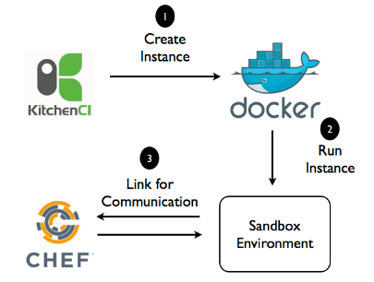
WORKFLOW:

Slide 25
Define cookbook: Develop and write Chef cookbooks to configure the desired infrastructure. This involves defining the necessary resources and dependencies, such as packages, users, services, and files.
Define tests: Write tests that validate the correctness of the cookbook. These tests can be written using different testing frameworks, such as ChefSpec, InSpec, and ServerSpec.
Define configuration: Write a configuration file that specifies the virtualization or containerization platform, operating system, and other configuration options. Test Kitchen supports multiple platforms, such as VirtualBox, Docker, and AWS.

Slide 26
Create test environment: Run Test Kitchen to create a virtual machine or containerized environment based on the defined configuration file. Test Kitchen will download the necessary software and configuration files, and then start the virtual machine or container.
Apply cookbook: Test Kitchen applies the Chef cookbook to the created environment.
Run tests: Test Kitchen runs the defined tests on the environment to verify that the cookbook is working as expected. This includes validating the configuration, checking the status of the resources, and verifying the presence of files and packages.

Slide 27
Destroy environment: Once the tests have completed, Test Kitchen will automatically destroy the created environment to clean up any resources used during testing.
Iterate and repeat: Test Kitchen is typically integrated into a continuous integration (CI) and continuous delivery (CD) workflow, allowing developers to iterate and improve the code based on feedback from the testing process.

Slide 28

HashiCorp Vagrant :
HashiCorp Vagrant is an open-source tool that allows developers to easily create and manage virtual development environments.
Vagrant supports a variety of virtualization providers, such as VirtualBox, VMware, and Hyper-V, among others.
Vagrant has a rich plugin system that allows developers to extend its functionality and integrate it with other tools and technologies.

Slide 29
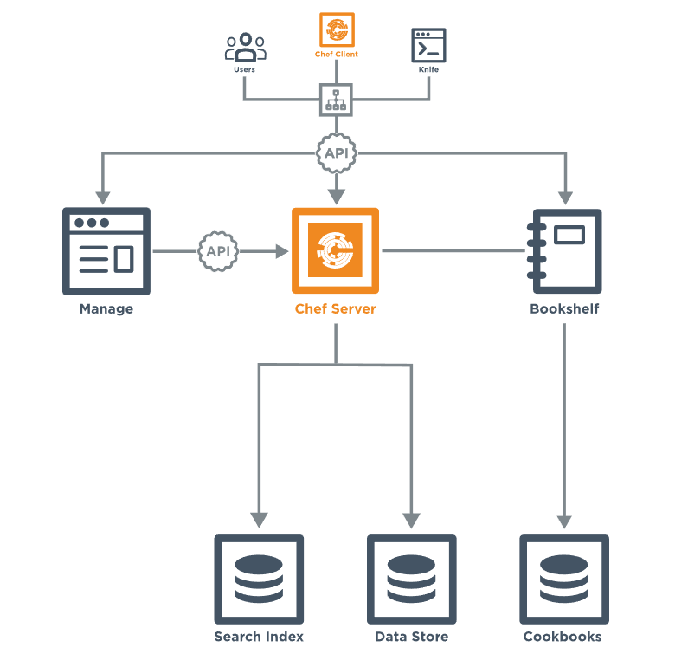
Chef Infra Server
The Chef Infra Server acts as a hub for configuration data. The Chef Infra Server stores cookbooks, the policies that are applied to nodes, and the metadata that describes each registered node that is under management by Chef Infra Client. Nodes use Chef Infra Client to ask the Chef Infra Server for configuration details

Slide 30
Server Components
Clients:
The Chef Infra Server is accessed primarily by nodes that are under management by Chef, as Chef Infra Client runs occur. It is also accessed by individuals who maintain cookbooks and policy that is stored on the Chef Infra Server, typically from a workstation. And also by individual users with credentials to Chef Infra Server components, such as the Chef management console.
Load Balancer:
Nginx is an open-source HTTP and reverse proxy server that is used as the front-end load balancer for the Chef Infra Server. All requests to the Chef Infra Server API are routed through Nginx.
Chef Manage:
Chef Manage is the web interface for the Chef Infra Server, which uses the Chef Infra Server API for all communication to the Chef Infra Server.
Bookshelf:
Bookshelf is used to store cookbook content—files, templates, and so on—that have been uploaded to the Chef Infra Server as part of a cookbook version. Cookbook content is stored by content checksum. If two different cookbooks or different versions of the same cookbook include the same file or template, Bookshelf will store that file only once. The cookbook content managed by Bookshelf is stored in flat files and is separated from the Chef Infra Server and search index repositories.

Slide 31
Search:
Search indexes allow queries to be made for any type of data that is indexed by the Chef Infra Server, including data bags (and data bag items), environments, nodes, and roles.A search is a full-text query that can be done from several locations, including from within a recipe, by using the search subcommand in knife, the search method in the Chef Infra Language, the search box in the Chef management console, and by using the /search or /search/INDEX endpoints in the Chef Infra Server API.
Data Bag:
Data bags store global variables as JSON data. Data bags are indexed for searching and can be loaded by a cookbook or accessed during a search.
Policy:
Policy defines how business and operational requirements, processes, and production workflows map to objects that are stored on the Chef Infra Server. Policy objects on the Chef Infra Server include roles, environments, and cookbook versions.

